Slide 1
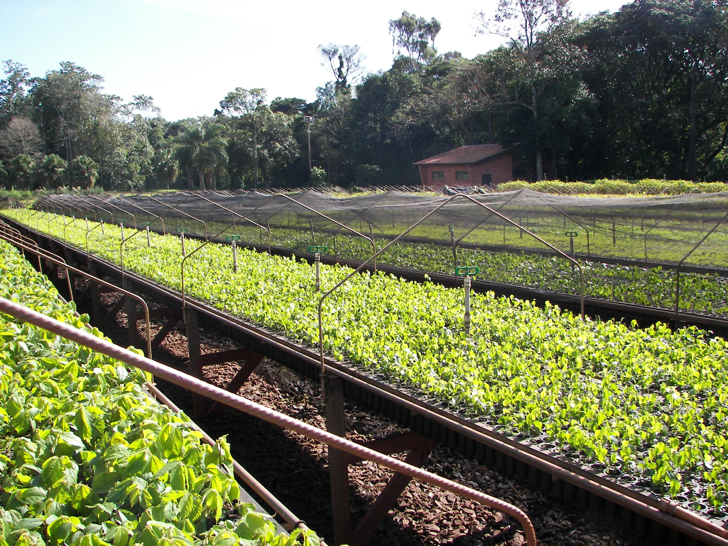




Cost Action Pan-European Network for Climate Adaptive Forest Restoration and Reforestation
Training school
Training School on nursery production and seedling quality for forest regeneration in South Europe
June 3-7, 2024
Universidad de Alcalá, Alcalá de Henares, Spain
Objective
The training school aims at providing an updated perspective on seedling production and quality assessment for forest plantations in south Europe, focusing especially on container plants for dry climate sites.
Organizer contact
Pedro Villar-Salvador (pedro.villar@uah.es)
Audience
What can I do to join the Training School? CLICK HERE
Young researchers, PhD students and any stakeholder working in forest restoration

